Slide 1


LECTUR 4 Solidity and Remix IDE 1
Hyoung Joong Kim
Kookmin University
March 31, 2026

Slide 2
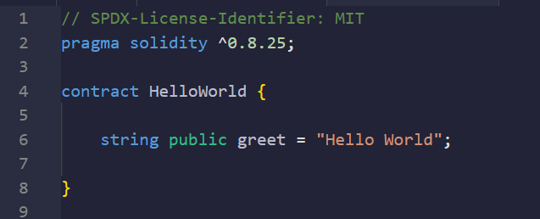
// SPDX-License-Identifier: MIT
pragma solidity ^0.8.25;
contract HelloWorld {
string public greet = "Hello World";
}
HelloWorld.sol

Slide 3
HelloWorld.sol
Alternative Licenses
GPL-3.0 - (Copyleft, requires derivative works to be open-source).
Unlicensed - (Proprietary, no permissions granted).
Apache-2.0 - (Similar to MIT but with patent protections).
SPDX (Software Package Data Exchange): A standard format for declaring software licenses.
MIT License: A permissive open-source license allowing free use/modification, with minimal restrictions (only requiring attribution).
Compiler Requirement: Since Solidity v0.6.8, the SPDX identifier is recommended (though not mandatory) to avoid compiler warnings.
If you omit license information, the Solidity compiler shows a warning (not an error).

Slide 4
HelloWorld.sol
Purpose: “pragma” tells the Solidity compiler which version to use (or accept) for the code.
Caret (^) Symbol: Means the code is compatible with Solidity versions.
^0.8.25 Explains:
From 0.0.25 up to (but not including) 0.9.0
Example: 0.8.25, 0.8.26, 0.8.29, but not 0.9.0
Fixed Version: pragma solidity 0.8.26; (only accepts exactly 0.8.26)
Version Range: pragma solidity >=0.8.26 <0.9.0 (same as ^ but explicit)

Slide 5
HelloWorld.sol
When You Deploy a contract
Compiled to EVM bytecode.
Given a unique address on the blockchain.
Becomes immutable (code can’t change after deployment).
Key Rules
One contract per file (though you can define multiple in one file).
Inheritance supported: contract Child is contract Parent {…}
Constructors: Use constructor() for initialization
Every smart contract begins with the contract keyword, followed by the contract's name and its code block.
contract: Declares a smart contract (similar to class in other language)
HelloWorld: The contract name (always starts with a capital letter by convention).
{}: Contains the contract's code (storage, functions, events, etc.).
Key Features of the contract Keyword
On-Chain Deployment: Contracts compiled to EVM bytecode and deployed to the blockchain.
Stateful: Can hold persistent data (state variables) and ETH balances.
Interoperable: Can call other contracts or be called by users/other contracts.

Slide 6
HelloWorld.sol
Part | Meaning
string | The variable type (a dynamic UTF-8 string).
public | Makes the variable readable by anyone (auto-generates a getter function).
greet | The variable name (customizable, e.g., message, welcomeText)
= “Hello World”; | Initial value assigned to the variable (stored on-chain permanently).
On-Chain Storage: The string is stored in the contract’s storage (costs gas to deploy/modify).
Deployment: Storing the string on-chain consumes gas (more expensive than memory variable.

Slide 7
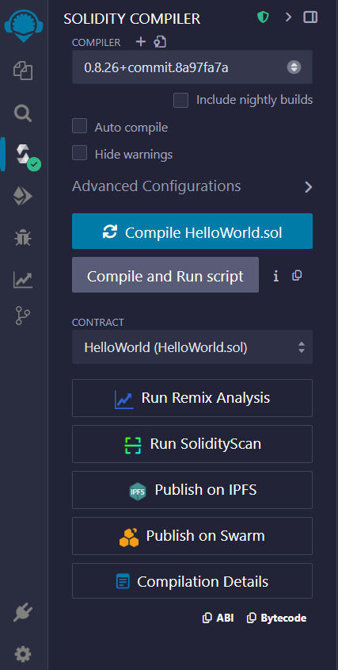
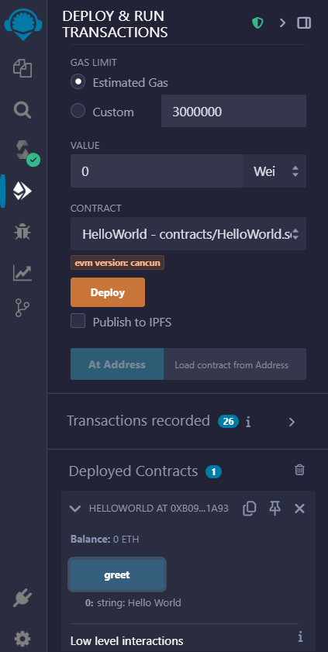
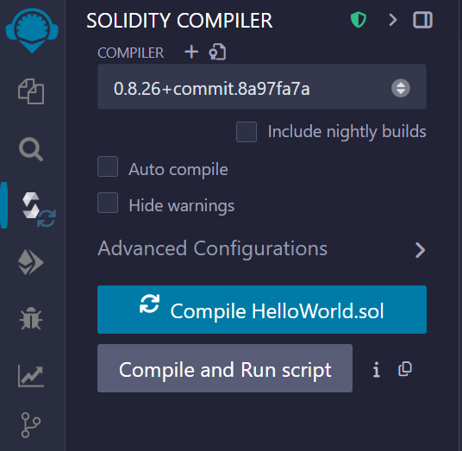
HelloWorld.sol

Slide 8
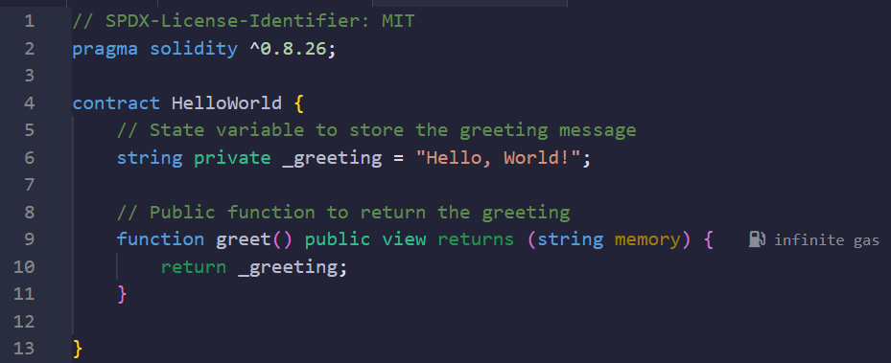
// SPDX-License-Identifier: MIT
pragma solidity ^0.8.26;
contract HelloWorld {
// State variable to store the greeting message
string private _greeting = "Hello, World!";
// Public function to return the greeting
function greet() public view returns (string memory) {
return _greeting;
}
}
HelloWorld.sol
Part | Meaning
private | Visibility modifier (only accessible within this contract)
_greeting | Variable name (underscore prefix is convention for private variables)
= “Hello, World”; | Initial value assigned to the variable (stored on-chain permanently).

Slide 9
// SPDX-License-Identifier: MIT
pragma solidity ^0.8.26;
contract HelloWorld {
// State variable to store the greeting message
string private _greeting = "Hello, World!";
// Public function to return the greeting
function greet() public view returns (string memory) {
return _greeting;
}
}
HelloWorld.sol
Feature | storage | memory | calldata
Persistence | Permanent | Temporary | Temporary
Mutability | Mutable | Mutable | Immutable
Gas Cost | High | Medium | Lowest
Typical Use | State variables | Local variables | External calls
Assignment | Reference types | Copy by value | Reference types

Slide 10
HelloWorld.sol
Part | Explanation
function greet() | Declares a function named greet.
public | Visibility: Can be called externally (by users/other contracts) and internally.
view | Function does not modify the contract's state (only reads data).
returns (string memory) | Specifies the return type (string) and its location (memory).
return _greet; | Returns the value of _greet (a state variable, assumed to be defined elsewhere).

Slide 11
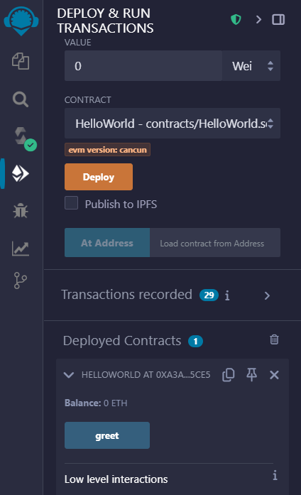
HelloWorld.sol
Function Calls in Solidity
No Internal Function Calls in Contract Definition
greet() is defined but not called within the contract
This is completely normal - the function waits to be called externally
2. Two Ways Functions Get Called
Externally: By users or other contracts (most common)
Internally: By other functions in the same contract (less common)

Slide 12
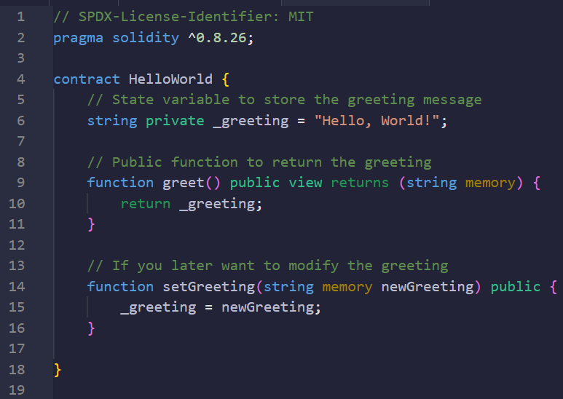
// SPDX-License-Identifier: MIT
pragma solidity ^0.8.26;
contract HelloWorld {
// State variable to store the greeting message
string private _greeting = "Hello, World!";
// Public function to return the greeting
function greet() public view returns (string memory) {
return _greeting;
}
// If you later want to modify the greeting
function setGreeting(string memory newGreeting) public {
_greeting = newGreeting;
}
}
HelloWorld.sol
Imagine a whiteboard (the contract) with "Hello, World!" written on it.
This function lets you erase that and write a new message instead.
If you call setGreeting(“Hi there!”), then greet() will return “Hi there!” instead of “Hello, World!”

Slide 13
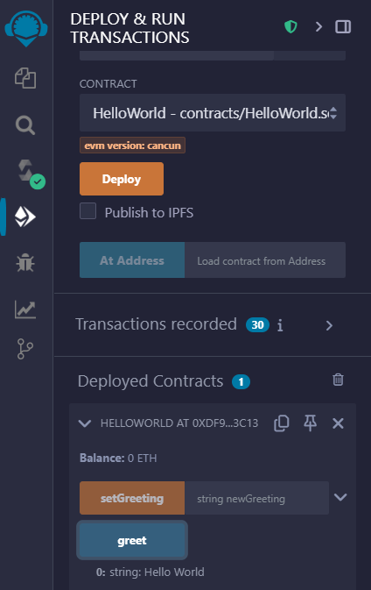
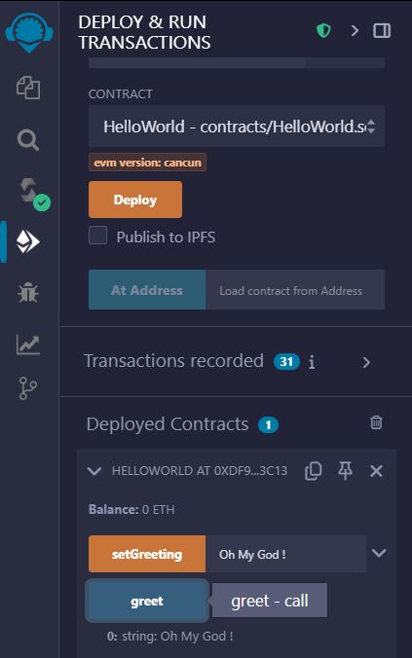
HelloWorld.sol

Slide 14
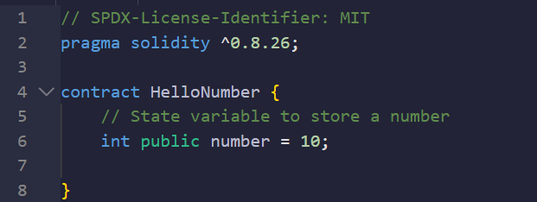
HelloNumber.sol
// SPDX-License-Identifier: MIT
pragma solidity ^0.8.26;
contract HelloNumber {
// State variable to store a number
int public number = 10;
}
Type | Bits | Range | Use Case
int8 | 8 | -128 to 127 | Tiny values (e.g., percentage)
int16 | 16 | -32,768 to 32,767 | Rarely used
int32 | 32 | -2.1e9 to 2.1e9 | Timestamps, small counters.
int64 | 64 | -9.2e18 to 9.2e18 | Medium-sized numbers.
int128 | 128 | -1.7e38 to 1.7e38 | Large numbers (common in DeFi).
int256 | 256 | -1.1e77 to 1.1e77 (default) | Most general-purpose arithmetic.

Slide 15
Practice
Expand the HelloNumber.sol.
Change the modifier public to private of the state variable “number”.
Add a function to output the “number” variable value. (See page 10 of this slide)
Add a function to output the “number” variable value getting from outside of the contract. (See page 11 of this slide)
Combine your expanded HelloNumber.sol and expanded HelloWorld.sol together so that we can see both “number” and “greeting”.

Slide 16
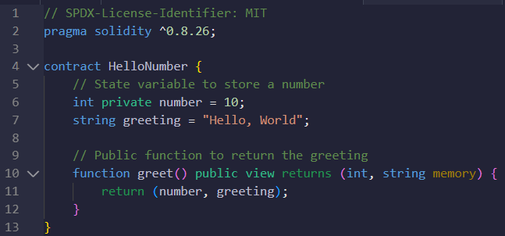
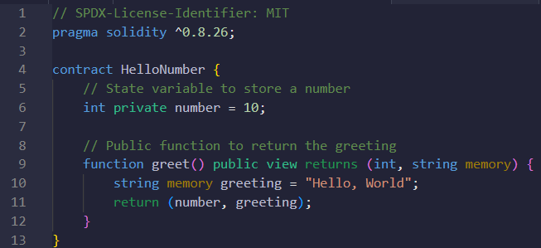
state variables
local variables

Slide 17
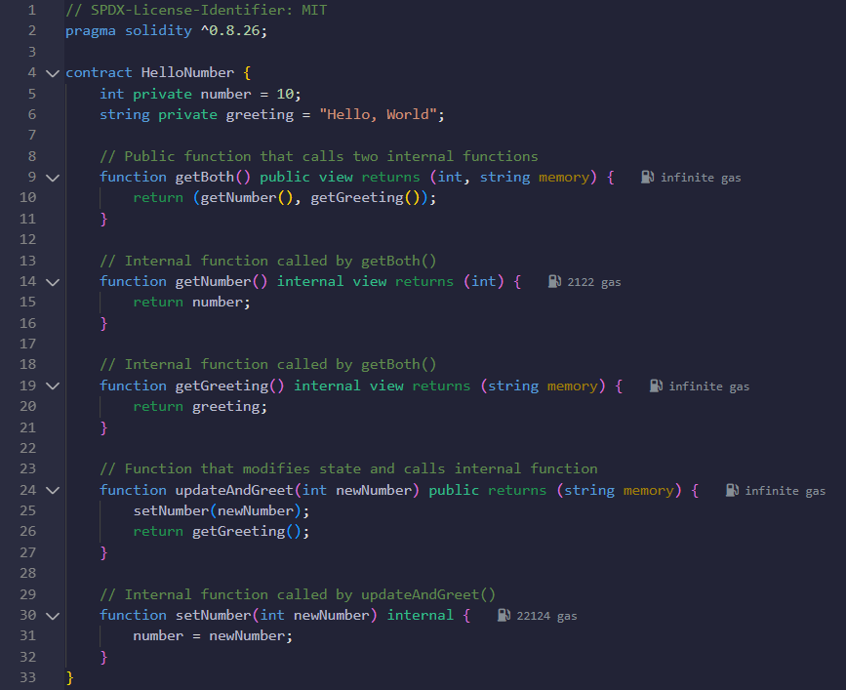
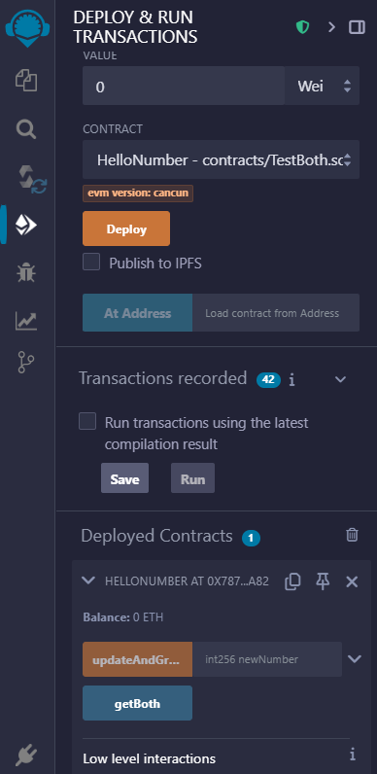

Slide 18
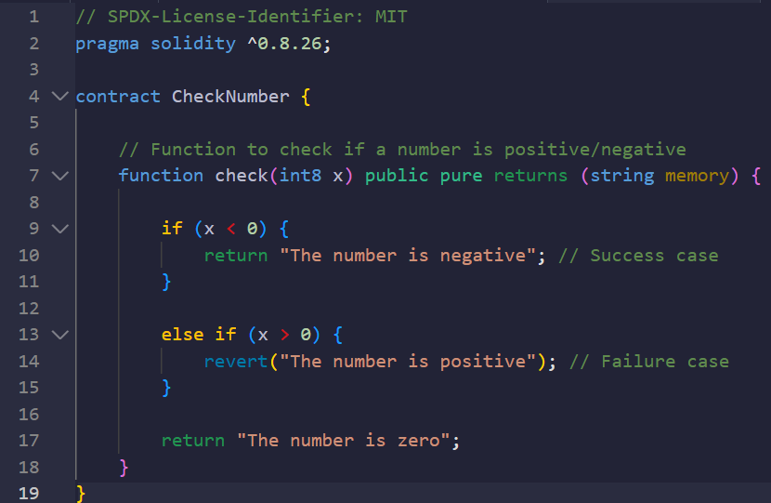
CheckNumber.sol
// SPDX-License-Identifier: MIT
pragma solidity ^0.8.26;
contract HelloNumber {
// State variable to store a number
int public number = 100;
// Function to check if a number is positive/negative
function check(int x) public pure returns (string memory) {
if (x > 0) {
return “The number is positive"; // Success case
} else if (x < 0) {
revert(“The number is negative"); // Failure case
}
return “The number is zero";
}
}

Slide 19
Modifier | Can Read State? | Can Modify State? | Gas Cost (External Call)
pure | No | No | 0 gas
view | Yes | No | 0 gas
(None) | Yes | Yes | Paid in gas
CheckNumber.sol
The pure keyword in Solidity is a function modifier that enforces two strict rules:
No Reading State: The function cannot access any contract state variables (like number in this example).
No Modifying State: The function cannot change any data on the blockchain (e.g., updating variables or sending ETH).
Why use PURE?
Gas efficiency: pure functions cost zero gas when called externally (because they don’t touch the blockchain).
Safety: Prevents accidental reads/writes to state.
Clarity: Signals to other developers that the function is a utility (e.g., math operations).

Slide 20
CheckNumber.sol
Command | Features
require(condition, “error”) | Cleaner for simple checks.
revert(“error”) | Better for complex logic.
The revert keyword in Solidity is like an emergency stop button for your smart contract. It immediately cancels the current transaction and can provide an error message.
Undoes All Changes: Any state modifications made before the revert are canceled.
Refunds Gas: Unlike the keyword assert, it refunds unused gas (except for a small fee).
Error Messages: You can include a string to explain why the revert happened.

Slide 21
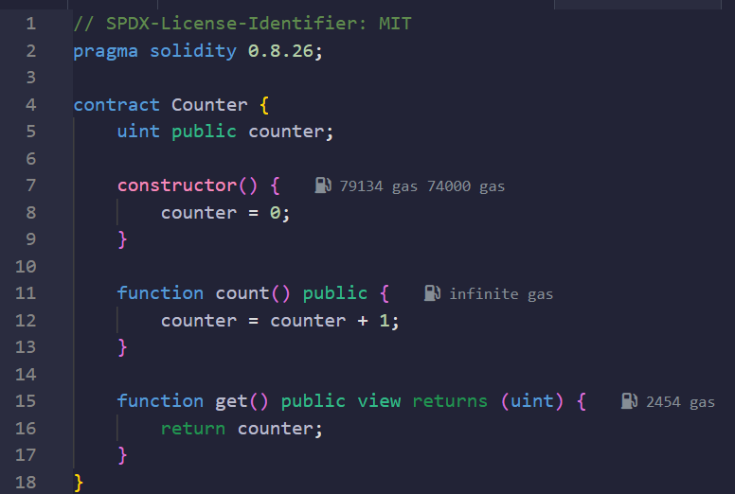
// SPDX-License-Identifier: MIT
pragma solidity 0.8.26;
contract Counter {
uint public counter;
constructor() {
counter = 0;
}
function count() public {
counter = counter + 1;
}
function get() public view returns (uint) {
return counter;
}
}
Counter.sol

Slide 22
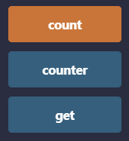
Counter.sol
Button Color Codes in Remix
Orange Button (count function)
Type: Transaction-writing function (changes state)
Color Meaning: Requires gas fee to execute
Behavior: Modifies the blockchain state (updates counter)
Green Buttons (counter and get function)
Type: View/read-only functions
Color Meaning: Free to call (no gas cost)
Behavior:
counter: Public variable auto-generated getter (green)
get: Explicit view function (green)
Button Color | Function Type | Gas Cost | Modifies State? | Example
Orange | State-changing (public) | Yes | Yes | count()
Green | view/pure/getter | No | No | get(), counter

Slide 23
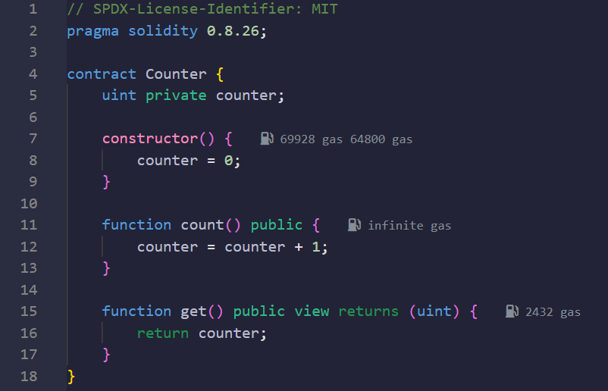
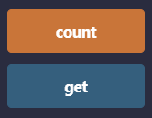
Counter.sol

Slide 24
Counter.sol
Feature | constructor() | Regular Function
Runs When? | On deployment | When called
Callable? | No | Yes
Gas Cost | Paid once (deployment) | Paid per call
The constructor is a special function that runs only once when your smart contract is deployed.
Initialize state variables (e.g., set the contract owner).
Configure initial settings (e.g., token name/symbol).
Perform one-time setup (e.g., deposit initial funds).
Key features are
Runs automatically on deployment (can't be called later).
No name needed: Declared with just constructor().
Can take arguments (passed during deployment).
Rule | Example
No return type | constructor() {…}
No manual calls | Can't call after deployment.
Only one allowed | No overloading (unlike Java/C++).
Rule | Example
No return type | constructor() {…}
No manual calls | Can't call after deployment.
Only one allowed | No overloading (unlike Java/C++).

